Slide 1
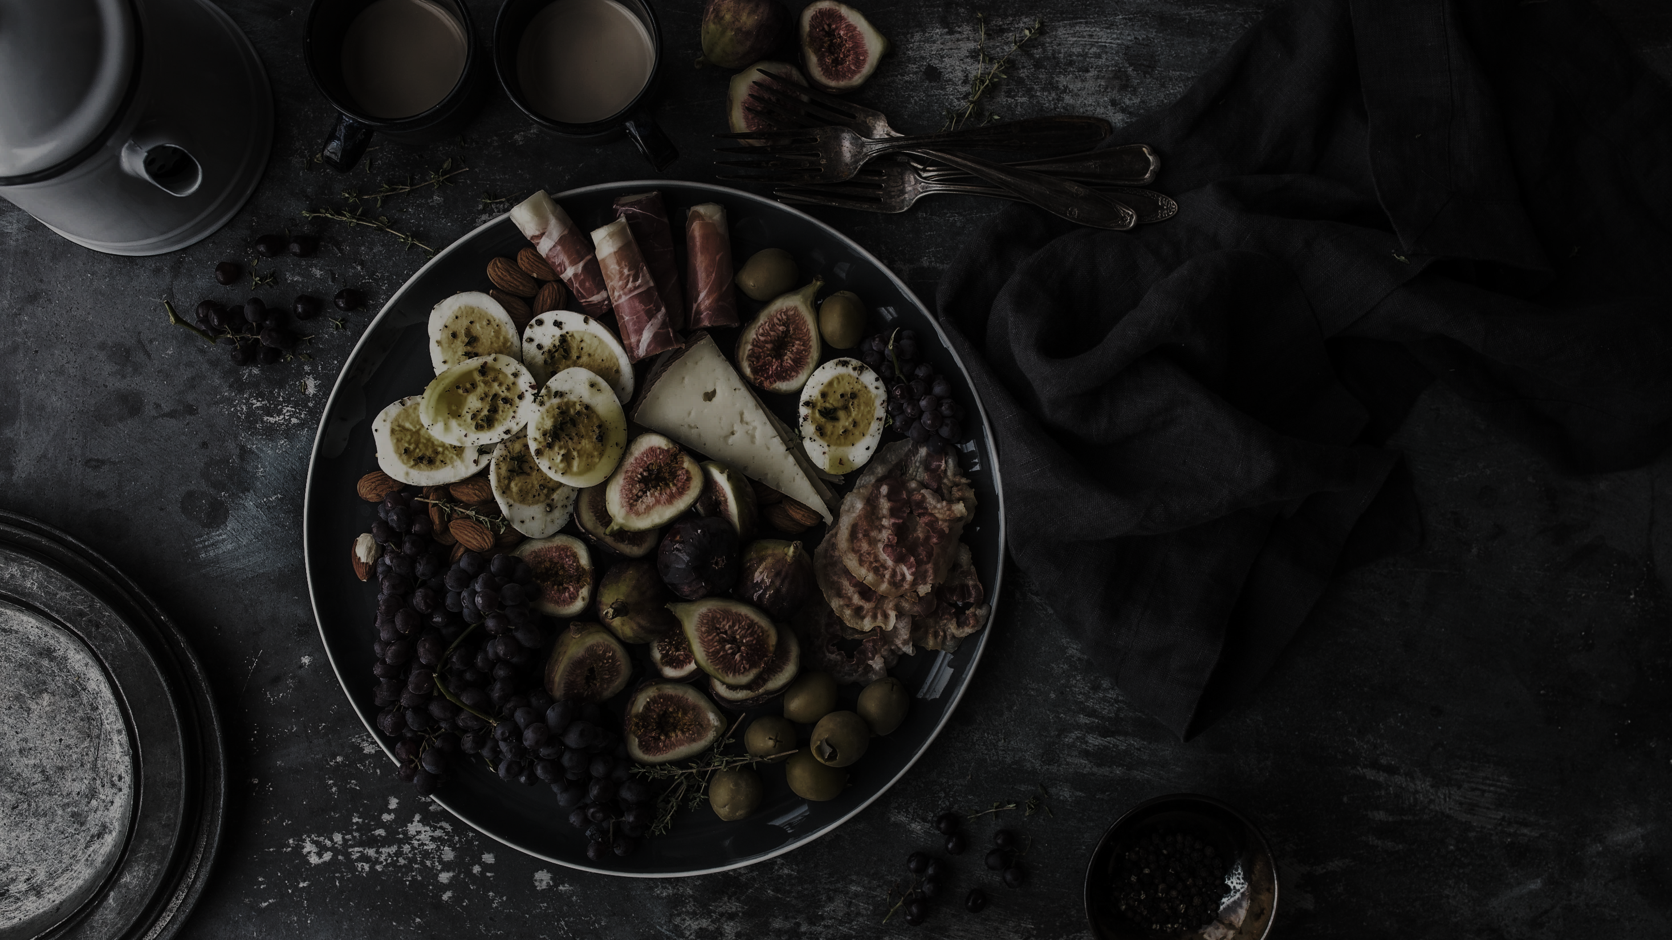
Welcome to
FoodRecipe
POWERPOINT TEMPLATE

Slide 2

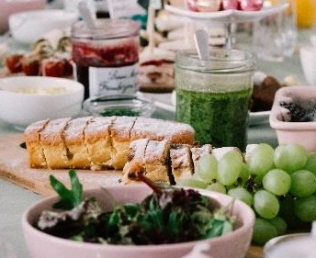
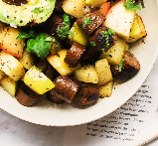
Davronov Shakhriyor
About
us
1
Programm
Tojiev
Javokhir
2
3
Khaydarov Elbek
4
Mirjalilov Abdulaziz

Slide 3


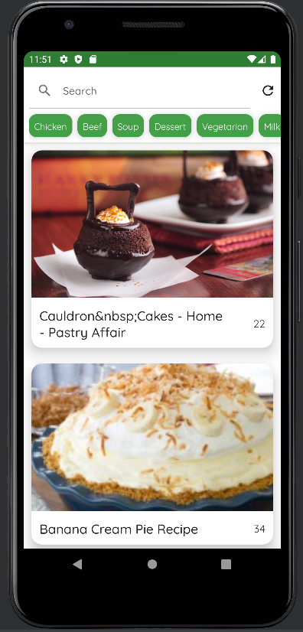
DELICIOUS
OUR MOCKUP.
Words full of wisdom that someone important said and can make the reader get inspired.
-Someone famous

Slide 4
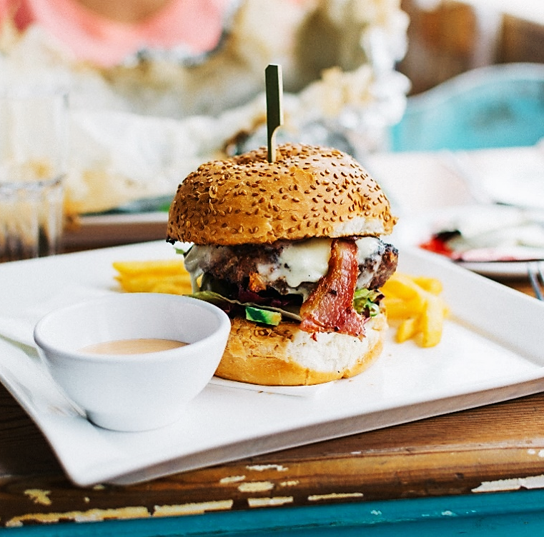
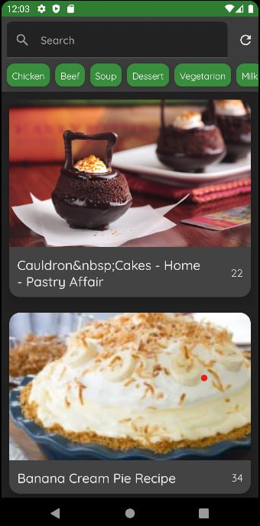
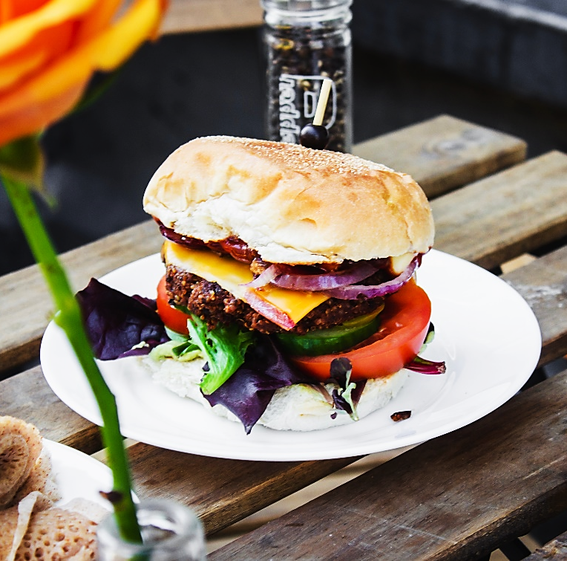
DELICIOUS
Night version.

